Slide 1
The Cell Environment
Jennifer Naples
DI Biology

Slide 2
Cell Membrane
Works as the gatekeeper of the cell
It is selectively permeable – it lets some substances in and denies others

Slide 3
Exiting and Entering the Cell
There are 3 ways substances enter and exit the cell
Diffusion
Osmosis
Active transport

Slide 4
Diffusion
Process by which molecules tend to move from an area of high concentration to an area of low concentration
WHY?
Particles are in constant motion
Particles in close contact will have collisions causing them to spread apart
Example – Oxygen passes through a cell membrane because the oxygen concentration is higher outside of a cell

Slide 5
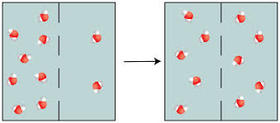
Diffusion
Particles diffuse across a membrane

Slide 6
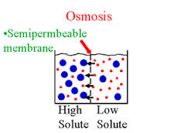
Osmosis
The diffusion of WATER molecules across a selectively permeable membrane.

Slide 7
Solutions
Isotonic – has the same concentration of water inside and outside of the membrane
Hypertonic – has a higher concentration of water inside the cell, water moves out of the cell
Hypotonic – lower concentration of water inside of the cell, water moves into the cell from surroundings

Slide 8
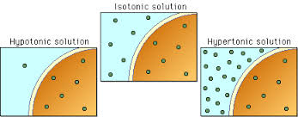
Types of Solutions
There are three types of solutions:

Slide 9
Active Transport
Diffusion and osmosis are examples of passive transport; no energy is required to move substances in and out of the cell.
Active transport – when substances must be moved against a concentration gradient
Requires the use of energy
This is done by using transport proteins that are in the cell membrane
Works like a doorway

Slide 10
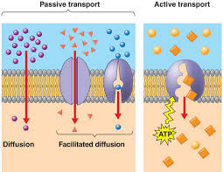
Active Transport
Transport proteins and active transport.

